Slide 1
TrustRank Algorithm
Srđan Luković 2010/3482 ls103482m@student.etf.rs

Slide 2
Introduction
The web is huge and is likely to get bigger!
Search engines dominate the Web business
Some people try hard to trick search engines to fulfill this goal
That means more bad (SPAM) pages
Pages created to fool search engines – SPAMDEXING.
Search engine business depends on
successful filtering of SPAM pages
<number> of 21

Slide 3
Some Spamming Techniques
Changing a color scheme for keyword stuffing:
e.g. white text on white background
Link farms - Creating a number of bogus web pages that link to one page in order to give it a better rank
Honey Pot - Provide some valuable content but contain links to SPAM pages
Registering many keyword-rich domains
Scraper sites – Scrape content from search engines and other websites
Article spinning – Rewriting existing articles to escape duplicate content penalty
Cloaking – Serving the page differently to the crawler than to the humans
<number> of 21

Slide 4
How do we filter out SPAM?
How do we separate the “good” ones from the “bad” ones?
It turns out its hard to do it automatically
The most reliable way is to use human experts but how do we do that for billions of pages?
Is there a way to conclude something based on a small set of pages reviewed by experts?
<number> of 21

Slide 5
Problem definition
How can we semi-automatically estimate which pages are good and which ones are bad (SPAM)
provided that we have a limited number of experts?
Can we reliably say which ones are probably good and/or probably bad
based on a small “seed” of pages reviewed by experts?
How can we do it effectively and efficiently?
<number> of 21

Slide 6
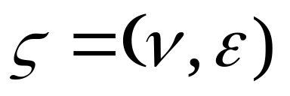

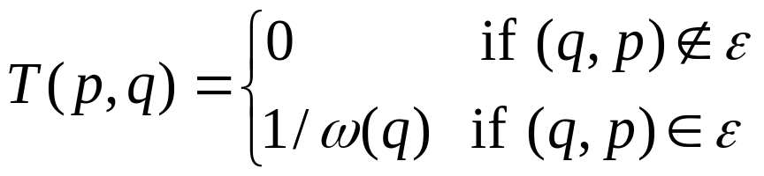
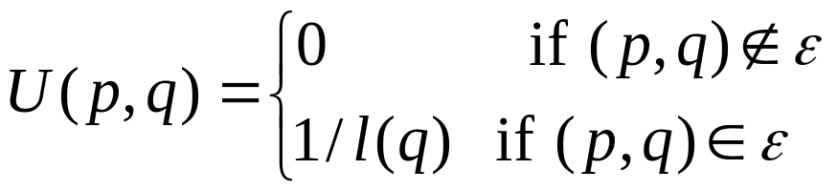
Basic Notions
Web Graph:
Indegree l(p) – the number of inlinks of a page p
Outdegree ω(p) - the number of outlinks of a page p
Transition matrix T
Inverse transition matrix U
<number> of 21

Slide 7
Finding T and U matrices
1
2
3
4
<number> of 21

Slide 8
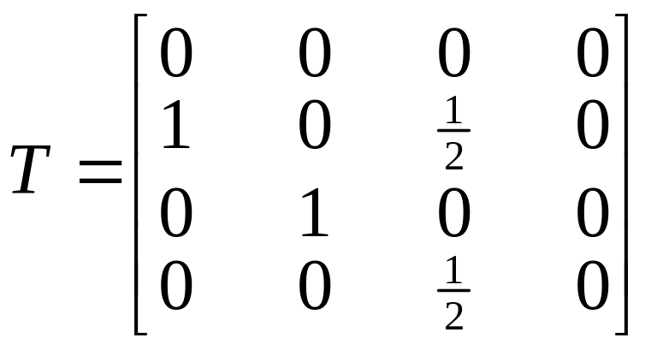
Finding T and U matrices
1
2
3
4
Outdegree ω(p) - the number of outlinks of a page p
<number> of 21

Slide 9
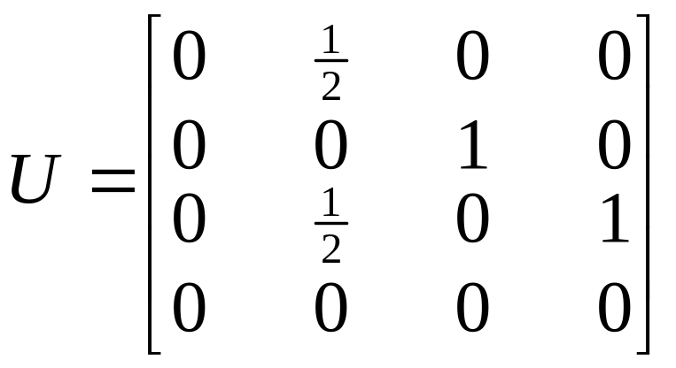
Finding T and U matrices
1
2
3
4
Indegree l(p) – the number of inlinks of a page p
<number> of 21

Slide 10
PageRank
Assigns global importance score to each page on the web by analyzing link information
Rationale: the number of inlinks to a webpage determines its importance
The score propagates via links to other webpages
Each link coming to a page is a vote
Problems
  Doesn’t incorporate any knowledge about a webpage
  Doesn’t discern good pages from bad ones
<number> of 21

Slide 11
PageRank
TrustRank relies on PageRank
Scores can be computed iteratively, usually in a fixed number of M iterations
Biased PageRank assigns a non-zero static score to special pages and
it gets distributed to others during computation
There are very efficient ways to calculate PageRank
<number> of 21

Slide 12
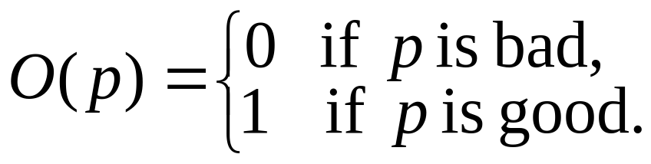
Oracle and Trust Function
The notion of human checking of a web page is represented by Oracle function:
Oracle invocations are expensive,
one should strive to minimize them
Important empirical observation for trust:
approximate isolation of the good set
Good pages rarely link to bad ones
The converse does not hold
<number> of 21

Slide 13
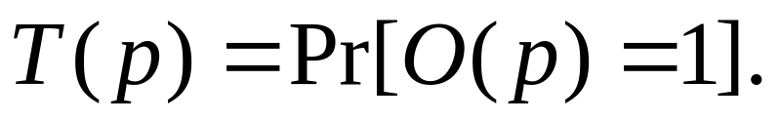
To evaluate the pages without calling O,
it is necessary to estimate the probability that p is good
The Trust function yields a range of values between 0 (bad) and 1 (good)
Ideally,
This is hardly ever true in practice
A relaxed constraint is orderedness by pair,
so that we can display search results based on that order
<number> of 21

Slide 14
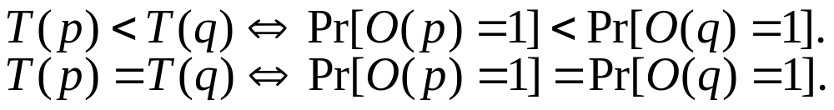
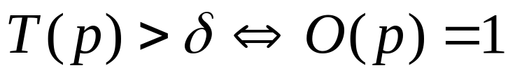
Another method of relaxing the requirements of T is
introducing a threshold value
If a page receives a score above δ we know it is good.
Otherwise, we cannot say anything
This does not necessarily provide ordering based on the likelihood of being good
<number> of 21

Slide 15
Seed selection
Random selection is simplest but
it may hinder TrustRank effectiveness
Oracle invocations are expensive,
because they require human effort
Chosen pages should be useful in identifying additional good pages
Seed set should be reasonably small to limit oracle invocations
<number> of 21

Slide 16
Trust flows out of the good seed pages, so give preference to pages which reach many other pages
Select pages based on the number of outlinks
Scheme closely related to PageRank
Difference is that importance depends on outlinks not inlinks
Inverse PageRank – compute PageRank on inversed transition matrix
Reuse of existing algorithms and their
good performance
<number> of 21

Slide 17
Good seed pages: A small set of trusted nodes (handpicked or verified as legitimate).
Good pages point to good pages: The assumption is that trustworthy entities are more likely to link to / interact with other trustworthy entities (e.g., verified social accounts connect with legitimate ones).
Reachability in ≤ M steps: If a node is reachable from a seed node by following at most M links, it inherits trust and is marked as good.
M=1: Only direct neighbours of seeds are considered good.
M=2: Neighbours of neighbours also considered good, and so on.
Beyond M steps, the reliability of the assumption decreases (spammers may creep in), so those are not automatically considered good.
<number> of 25

Slide 18
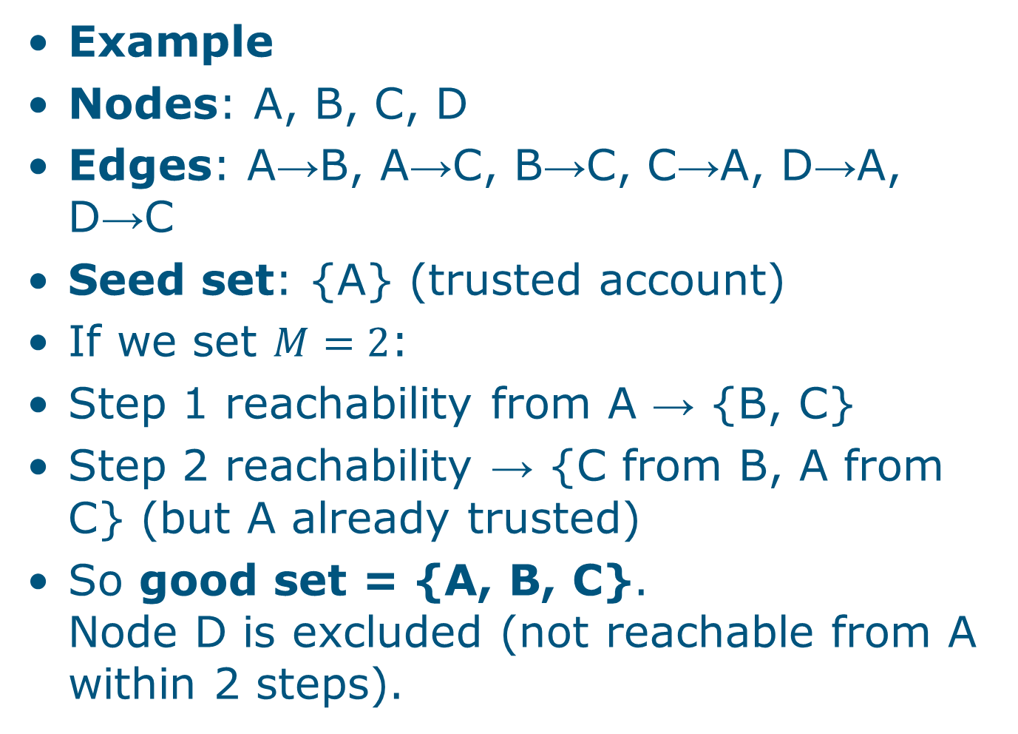
<number> of 25

Slide 19
Trust propagation
Expecting that good pages point to other good pages, all pages reachable from a good seed page in M or fewer steps are denoted as good
1
2
3
4
good page
5
6
bad page
7
<number> of 21

Slide 20
S = {1, 3, 6} set of seed pages
M = 1..3 maximum length path
1
2
3
4
5
6
7
<number> of 21

Slide 21
Trust attenuation
We cannot be absolutely sure that pages reachable from good seeds are indeed good
Further away we are from good seed,
less certain we are that a page is good
Trust dampening
β – dampening factor
Trust splitting
Can be combined
β
β²
1
β
2
β²
3
β
1/2
t(1)=1
1
5/12
1/2
3
1/3
5/12
t(2)=1
2
1/3
t(3)=5/6
1/3
<number> of 21

Slide 22
TrustRank in Action
Select seed set using inversed PageRank
σ=[2, 4, 5, 1, 3, 6, 7]
Invoke L(=3) oracle functions
Populate static score distribution vector
d=[0, 1, 0, 1, 0, 0, 0]
Normalize distribution vector
d=[0, 1/2, 0, 1/2, 0, 0, 0]
Calculate TrustRank scores using biased PageRank with trust dampening and trust splitting
RESULTS [0, 0.18, 0.12, 0.15, 0.13, 0.05, 0.05]
0
1
0.12
2
0.18
3
0.15
4
0.13
0.05
5
6
7
0.05
<number> of 21

Slide 23
Conclusions
These results only give us the order of the pages
That is good enough for search results
We can use threshold value to determine only good pages
Page 1 is non-referenced, so it doesn’t have rank
Spam page 5 is highly rated because of inlink from good page
On real world web graph these exceptions are rare
<number> of 21

Slide 24
Further improvements
During the seed selection it is not necessary to order all pages using inversed PageRank
If we already have PageRank score, we can choose subset of highly ranked pages
Users will be more interested in those pages anyway
We may determine TrustRank of smaller number of pages, but
those will be more important
<number> of 21

Slide 25
References
[1] Z. Gyongyi, H. Garcia-Molina and J.Pedersen. Combating Web Spam with TrustRank. Tech. rep., Stanford University, 2004.
[2] Z. Gyongyi and H. Garcia-Molina. Seed selection in TrustRank. Tech. rep., Stanford University, 2004.
<number> of 21

